Slide 1
文献汇报
汇报人：许淑乐

Slide 2
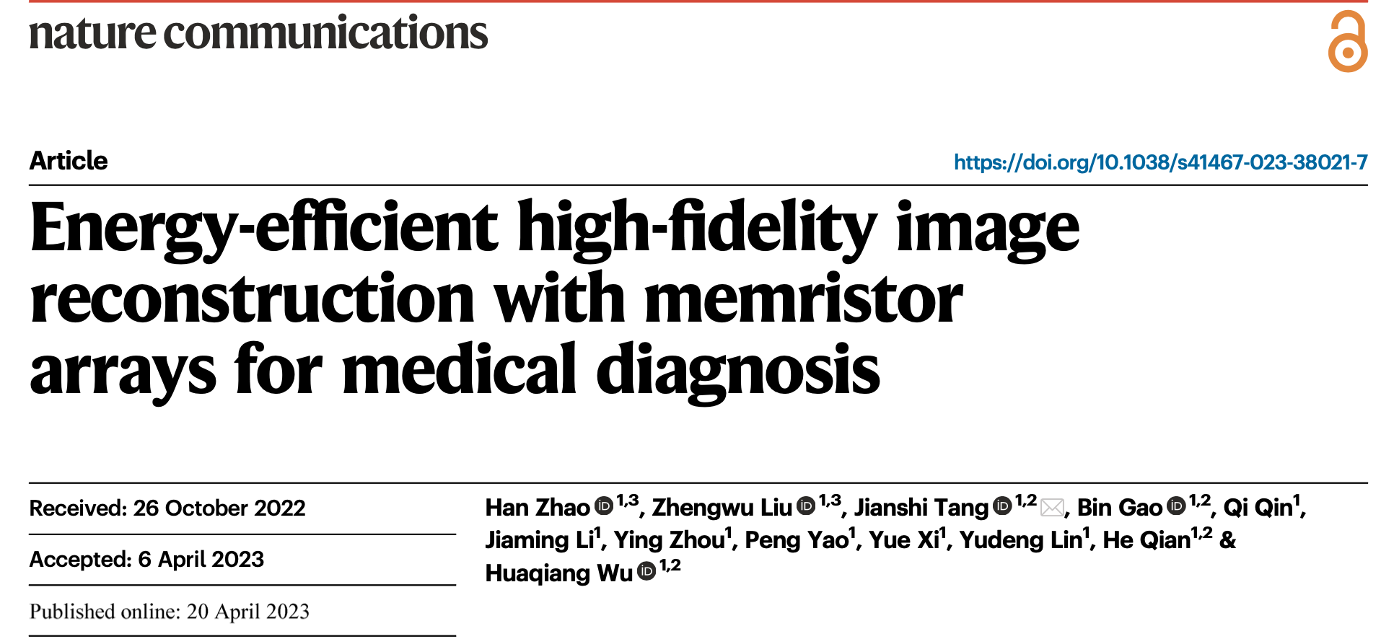
Notes:
医学成像是准确医学诊断的重要工具，而先进的图像重建算法在高速和高质量成像的大数据处理方面提出了关键挑战。在这里，我们提出了一种基于忆阻器阵列的忆阻图像重建器（MIR），通过在内存中计算（CIM）大大加速了具有离散傅立叶变换（DFT）的图像重建。提出了一种高精度的准模拟映射（QAM）方法和通用的复杂矩阵传输（CMT）方案，以分别提高映射精度和传输效率。演示了高保真的磁共振成像（MRI）和计算机断层扫描（CT）图像重建，经过nnU-Net算法分割后实现了与软件等效的质量和DICE分数。值得注意的是，与图形处理单元（GPU）相比，我们的MIR在能效和标准化图像重建速度方面分别展现了153倍和79倍的提升。这项工作展示了MIR作为未来医学诊断的有前途的高保真图像重建平台，并且也在很大程度上拓展了基于忆阻器的CIM在人工神经网络以外的应用。

Slide 3
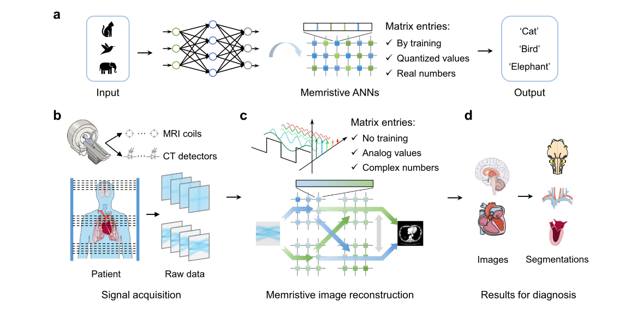
Illustration of memristive ANNs and medical imaging system
In this work, we propose and demonstrate a memristive image reconstructor (MIR), whose core is a memristive DFT (Fig. 1c).
To efficiently implement DFT on memristor arrays, we have developed two strategies, quasi-analog mapping (QAM) and complex matrix transferring (CMT) scheme, to improve the mapping precision and transfer efficiency, respectively.
With QAM, memristive DFT results achieves better consistency with software-calculated results, com- pared with the conventional quantized mapping (QM) method.
With CMT, memristive DFT also has a smaller overhead of peripheral circuits, compared to conventional real-imaginary separated scheme.
1.memristive image reconstructor (MIR)
2. discrete Fourier transformation (DFT)
3. magnetic resonance imaging (MRI)
4. computed tomography (CT)
Energy-efficient high-fidelity image reconstruction with memristor arrays for medical diagnosis
Notes:
开发一种在忆阻器阵列上高效实现DFT等信号处理算法的新方案。在这项工作中，我们提出并展示了一种忆阻图像重建器（MIR），其核心是忆阻DFT。为了在忆阻器阵列上高效实现DFT，我们开发了两种策略，准模拟映射（QAM）和复杂矩阵传输（CMT）方案，以分别提高映射精度和传输效率。通过QAM，与传统的量化映射（QM）方法相比，忆阻DFT的结果与软件计算结果更一致。通过CMT，与传统的实部-虚部分离方案相比，忆阻DFT的外围电路开销也较小。

Slide 4
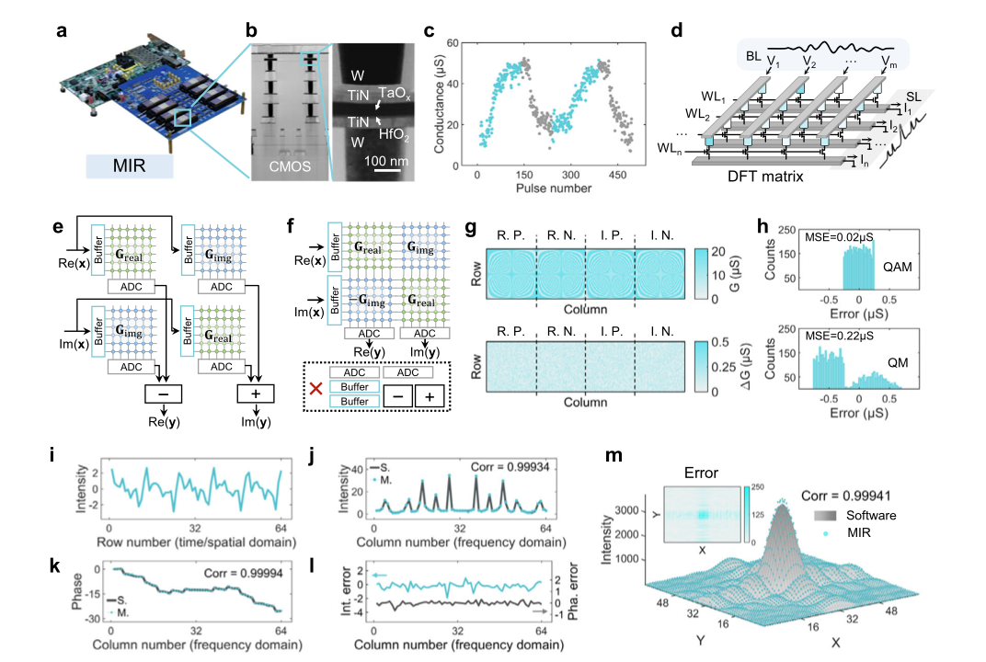
The implementation of memristive image reconstructor (MIR).
We construct the MIR based on our customized memristor hardware platform (Fig. 2a)
As shown in Fig. 2d, the computation of DFT can be regarded as a multiplication of time/spatial-domain input signal and a DFT matrix, and the output result following the Ohm’s law and Kirchhoff’s current law represents the frequency-domain signal.
As shown in Fig. 2f, by assembling the four same-size DFT matrices into an integrated matrix, both the real and imaginary parts of DFT results can be directly obtained in a single step because the addition and subtraction operations can be realized inside the memristor array rather than by peripheral circuits, reducing the computing latency.
Energy-efficient high-fidelity image reconstruction with memristor arrays for medical diagnosis
Notes:
我们基于自定义的忆阻硬件平台（图2a）构建了MIR，该平台包括八个2K单元的忆阻器阵列。
如图2d所示，DFT的计算可以看作是时间/空间域输入信号与DFT矩阵的乘法，根据欧姆定律和基尔霍夫电流定律，输出结果表示频域信号。
如图2f所示，通过将四个相同大小的DFT矩阵组装成一个集成矩阵，可以在单个步骤中直接获得DFT结果的实部和虚部，因为加法和减法运算可以在忆阻器阵列内部而不是通过外围电路实现，从而降低计算延迟。

Slide 5
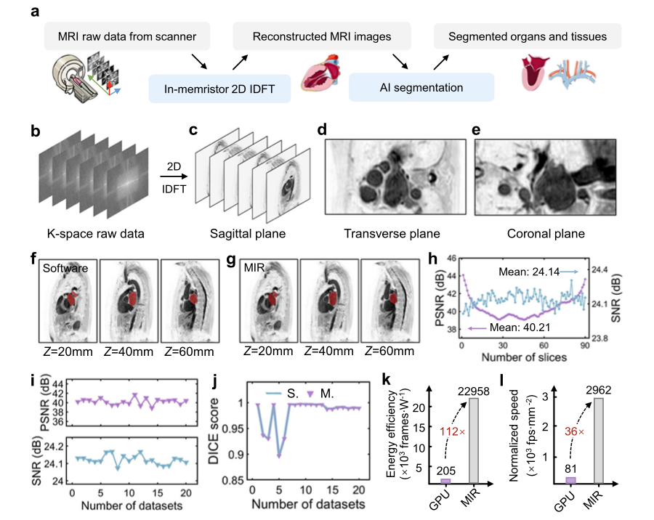
MRI image reconstruction with MIR
Figure 3b shows the raw data from MRI scanner sampled in K-space. Through our memristive 2D IDFT, a series of sagittal plane images are reconstructed (Fig. 3c) to finally obtain a 3D MRI image.
The benchmark in Fig. 3k-l further reveals that MIR is 112× higher in energy efficiency and 36× higher in normalized image reconstruction speed than Nvidia Tesla V100 GPU
Energy-efficient high-fidelity image reconstruction with memristor arrays for medical diagnosis
Notes:
图3a说明了完整的MRI数据处理过程。来自MRI扫描仪的原始数据在K空间（2D傅立叶空间）中采样，然后输入到MIR中。然后执行2D IDFT将数据转换为人体切片图像（重建的MRI图像）在空间域中。接下来，通常进行医学图像分割，以注释感兴趣的区域进行医学诊断，其中分割质量在很大程度上影响诊断准确性。在这项工作中，忆阻器和阵列的非理想设备特性，如读取噪声（如附图2所示），卡住错误（如附图6所示），映射错误和互连电阻，可能会降低MIR对重建图像的质量。为了验证MIR图像中的关键信息是否得以保留，我们使用nnU-Net处理来自软件和MIR的重建图像，并获取分割的人体器官或组织，这些结果用于比较，以检查MIR的重建图像质量和计算精度。

Slide 6
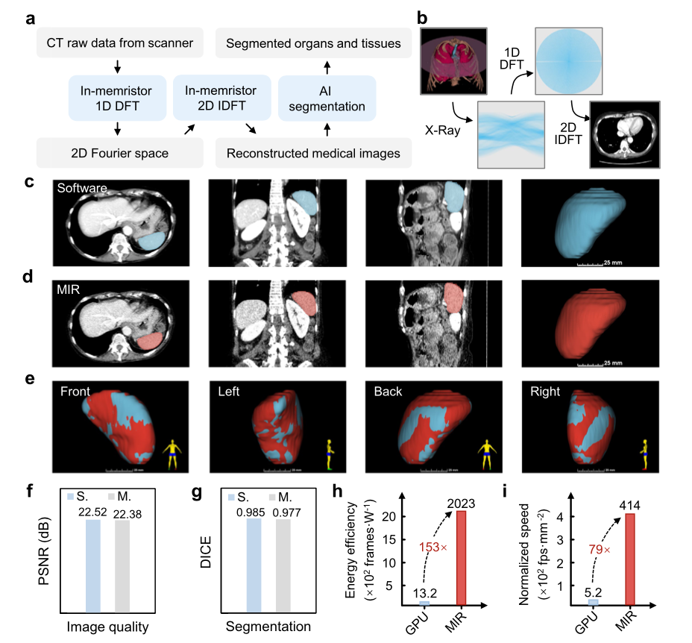
CT image reconstruction with MIR
Fig. 4a. During CT scan, X-ray projections of human body from various angles are processed to produce cross-sectional images (slices) for diagnostic and therapeutic purposes. Each projection vector is fed to MIR for DFT, yielding frequency- domain signal in 2D Fourier space.
Then reconstructed CT images can be obtained by performing 2D IDFT on the 2D Fourier space.
During the entire CT image reconstruction process, three steps of DFT in total are required to transform the raw projections into CT images.
Finally, organs or tissues can be segmented by nnU-Net from the reconstructed CT images.
Energy-efficient high-fidelity image reconstruction with memristor arrays for medical diagnosis
Notes:
数据处理过程如图4a所示。在CT扫描过程中，来自各个角度的人体X射线投影经过处理，产生用于诊断和治疗目的的横截面图像（切片）。每个投影矢量都输入到MIR进行DFT，产生2D傅立叶空间中的频域信号。然后，通过对2D傅立叶空间执行2D IDFT，可以获得重建的CT图像。在整个CT图像重建过程中，总共需要三步DFT，将原始投影转换为CT图像。最后，可以通过nnU-Net从重建的CT图像中分割出器官或组织。例如，图4b显示了原始人体器官和重建的CT图像43以及中间结果。

Slide 7
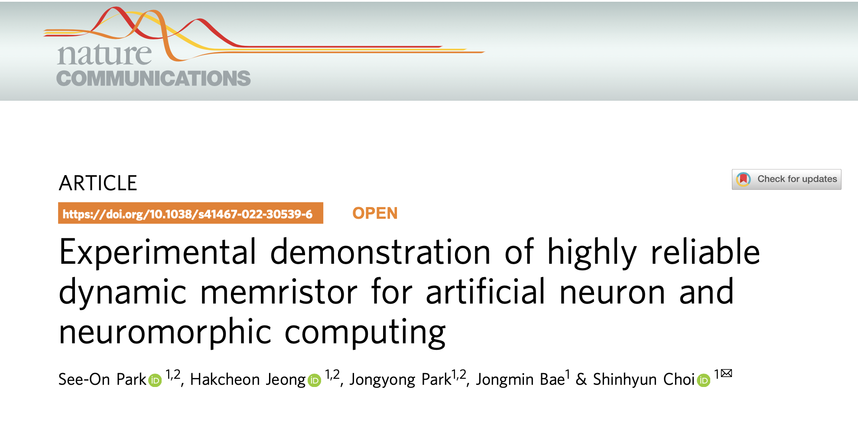
Notes:
神经形态计算是一种受人脑启发的计算范式，能够实现高效能、快速的人工神经网络。为了处理信息，神经形态计算直接模拟了人脑中生物神经元的运作方式。为了有效地用电子设备模拟生物神经元，基于电阻存储器的人工神经元引起了关注，因为其结构简单、能效高、可扩展性强。然而，电阻存储器的不可靠性问题一直是基于电阻存储器的人工神经元和神经形态计算发展的主要障碍之一。在这里，我们展示了一种没有晶体管设备的电阻存储器1R交叉阵列，用于单个电阻存储器访问，具有低变异性、100%良率、大动态范围和快速速度，适用于人工神经元和神经形态计算。基于开发的电阻存储器，我们在实验证明了具有良好可靠性的漏电积分放电特性的电阻存储器神经元。此外，我们基于开发的电阻存储器的短时记忆效应，开发了一个用于高效处理序列数据的神经-电阻计算系统。我们的神经-电阻计算系统成功训练并生成了生物医学序列数据（抗菌肽），同时使用了少量的训练参数。我们的结果为基于电阻存储器的人工神经元和神经形态计算系统的发展打开了可能性，这对于能效高的边缘计算设备至关重要。

Slide 8
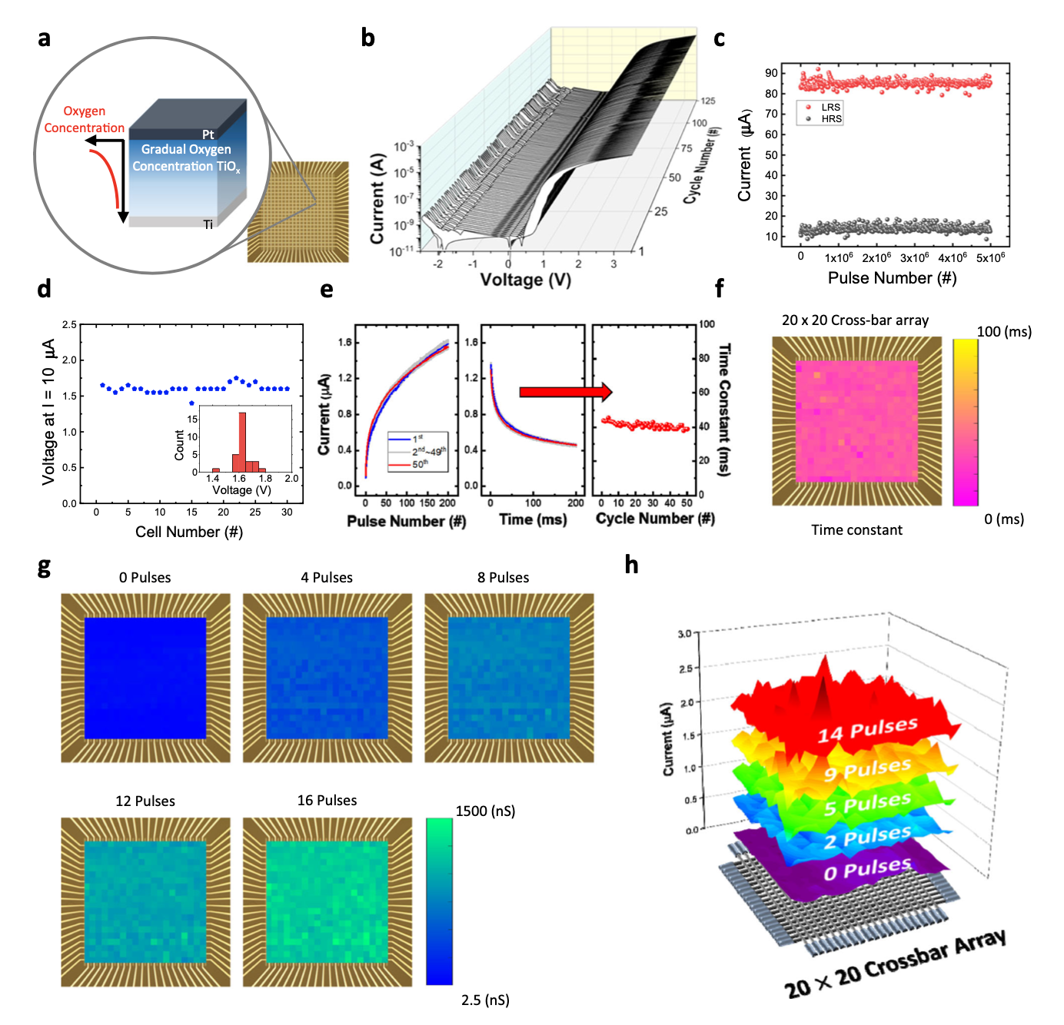
Characteristics of gradual TiOx-based memristor
1. high rectifying ratio (current at Vread/current at −Vread)
2. the high on/off ratio
3. forming-free and compliance current-free
4. a low temporal variation
Experimental demonstration of highly reliable dynamic memristor for artificial neuron and neuromorphic computing
Notes:
高整流比（在Vread时的电流/在−Vread时的电流）
高开关比
无需成形并且无须适应电流
低时间变异

Slide 9
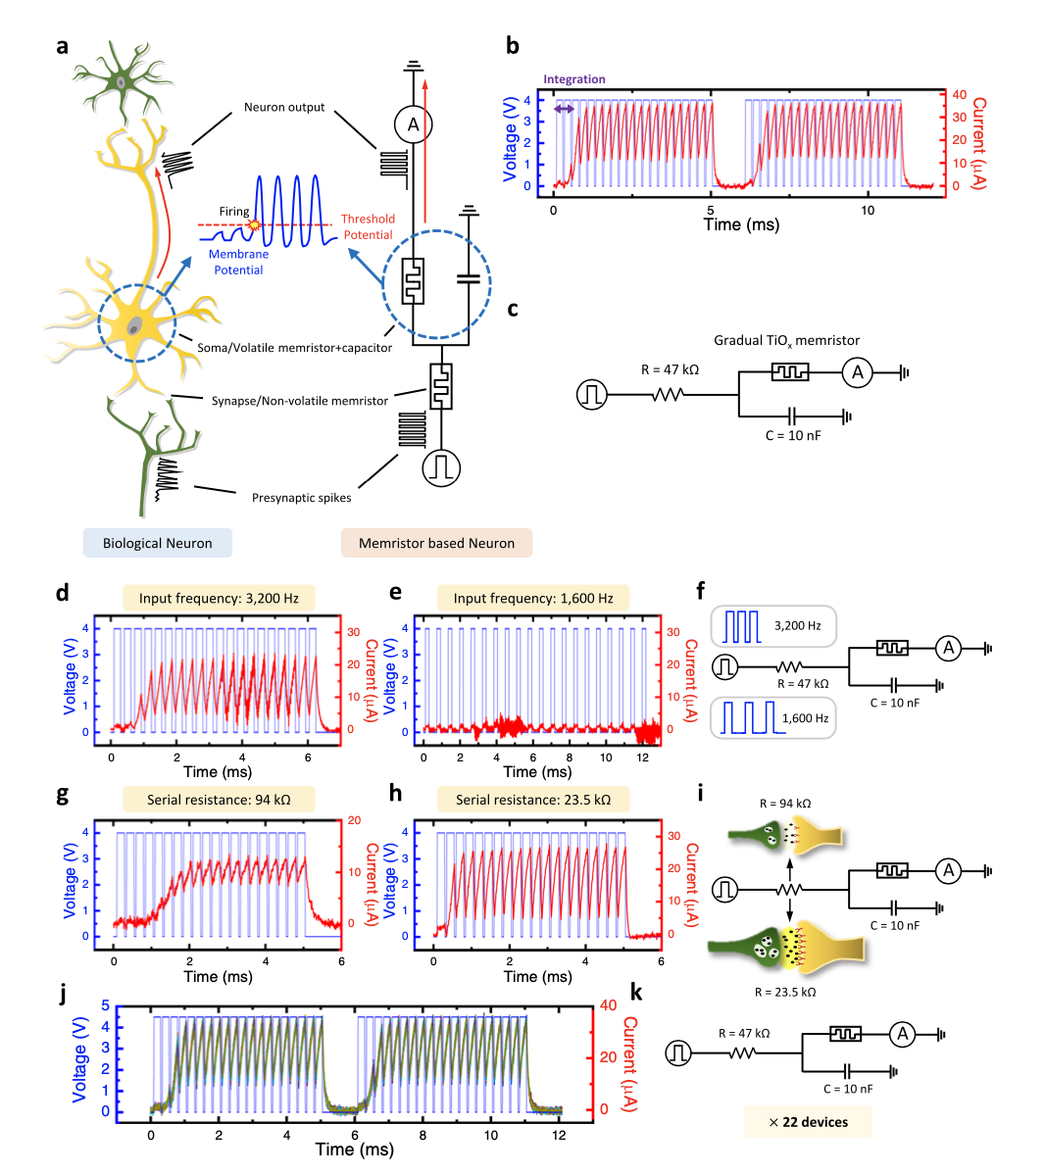
Gradual TiOx memristor-based LIF neuron
A biological neuron receives spike signals from presynaptic neurons and integrates the signals into its membrane potential (see Fig. 3a).
the gradual TiOx memristor-based LIF neuron is constructed with a parallel capacitor and a serial resistor
The parallelly connected volatile memristor and capacitor operate as a LIF neuron’s soma
The resistor (or non-volatile memristor), that serves as a synaptic weight
Experimental demonstration of highly reliable dynamic memristor for artificial neuron and neuromorphic computing
Notes:
生物神经元接收来自突触前神经元的尖峰信号，并将信号整合到其膜电位中（见图 3a）。
基于 TiOx 忆阻器的渐变 LIF 神经元由并联电容器和串联电阻构成
并联的易失性忆阻器和电容器作为 LIF 神经元的胞体运行
用作突触权重的电阻器（或非易失性忆阻器）

Slide 10
Gradual TiOx memristor-based LIF neuron
In a biological neuron, the neuron easily fires when it receives spikes from a strongly connected presynaptic neuron, while it requires much more spikes to fire when the presynaptic neuron is weakly connected.
This biological phenomenon is emulated in our artificial neuron by modifying the synaptic weight from the serial resistor (see Fig. 3b, g–i).
Fig.j Every neuron operates in the same manner, without any noticeable differences.
The low variation of the artificial neuron originates from the reliable switching behavior of the gradual TiOx memristor.
Experimental demonstration of highly reliable dynamic memristor for artificial neuron and neuromorphic computing
Notes:
此外，在生物神经元中，当神经元从一个强连接的前突触神经元接收到脉冲时，它很容易发放，而当前突触神经元连接较弱时，需要更多的脉冲才能发放。通过调整串联电阻的突触权值（见图3b，g–i），在我们的人工神经元中模拟了这一生物现象。
在人的生物神经网络中，当后突触神经元在前突触神经元发放后立即发放时，突触权值会长期强化，因为这意味着后突触神经元的发放事件与前突触神经元的发放强相关。这一生物现象被称为“Hebb学习规则”，被认为是生物神经网络的基本学习机制23。结果表明，基于电阻存储器的人工神经元表现出与生物LIF神经元相似的特性
图 j 每个神经元都以相同的方式运行，没有任何明显的差异。人工神经元的低变化源于渐变 TiOx 忆阻器的可靠开关行为。

Slide 11
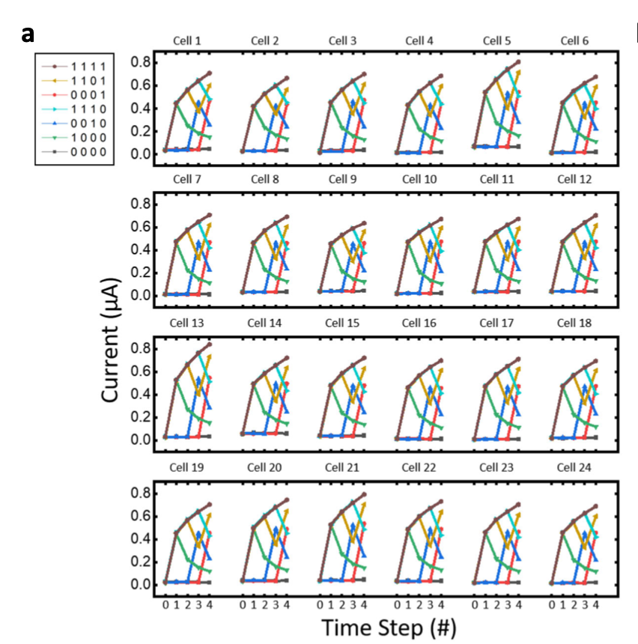
Binary and sequence input processing of the gradual TiOx memristor.
Each memristor shows an identical and uniform response to the 4-bit input due to the excellent uniformity of the gradual TiOx memristor.
Experimental demonstration of highly reliable dynamic memristor for artificial neuron and neuromorphic computing
Notes:
由于渐变 TiOx 忆阻器具有出色的均匀性，每个忆阻器对 4 位输入表现出相同且一致的响应。

Slide 12
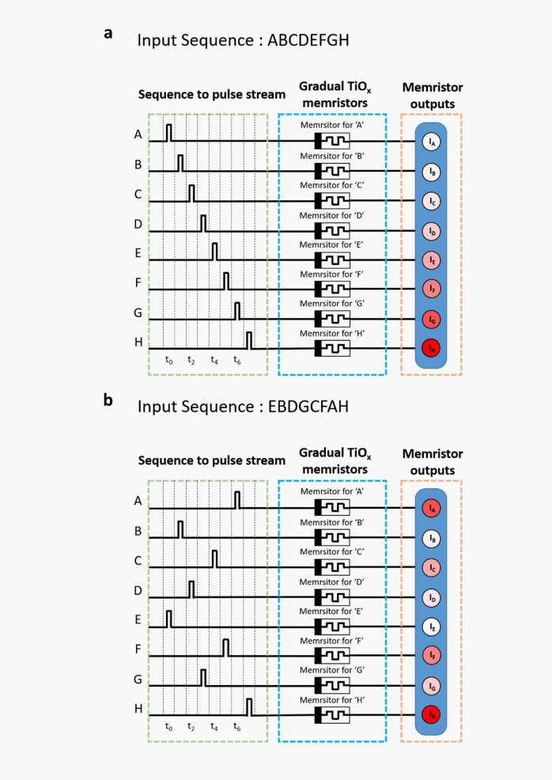
A schematic of the memristors processing two different sequence input
The sequences are converted to a pulse train and the pulse train is fed into the memristors. The memristor assigned to the character is potentiated by the pulse, while the others are rested and naturally decayed. Because of the self-decaying (short-term memory) property, the latest pulses strongly affect the memristors’ current states, while the former pulses hardly affect the current state, as the information is already lost due to the decaying effect
Experimental demonstration of highly reliable dynamic memristor for artificial neuron and neuromorphic computing
Notes:
如补充图16所示，结合交叉阵列。将序列转换为脉冲列，并将脉冲列馈送到电阻存储器中。应用于字符的电阻存储器通过脉冲增强，而其他电阻存储器则休息并自然衰减。由于自衰减（短时记忆）特性，最新的脉冲会强烈影响电阻存储器的电流状态，而以前的脉冲几乎不会影响当前状态，因为由于衰减效应，信息已经丢失。因此，序列历史的信息可以表示为分配给电阻存储器的电导水平。在最终的时间步骤中获得所有电阻存储器的最终电导状态。

Slide 13
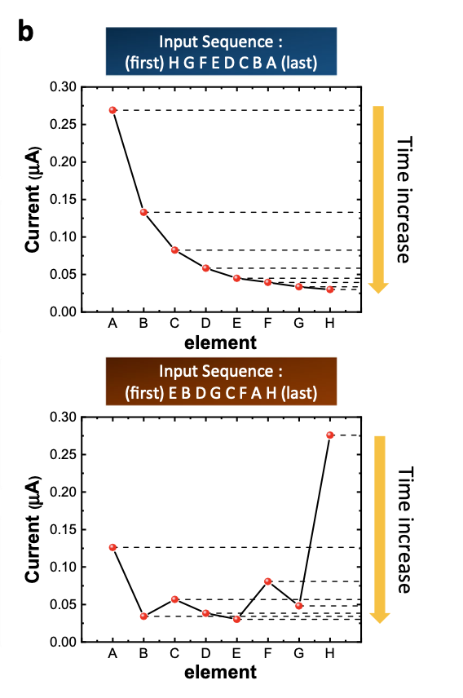
Binary and sequence input processing of the gradual TiOx memristor.
the outcome of the memristors distinguishes the differently ordered alphabet sequences.
Experimental demonstration of highly reliable dynamic memristor for artificial neuron and neuromorphic computing
Notes:
忆阻器的结果区分了不同顺序的字母序列。

Slide 14
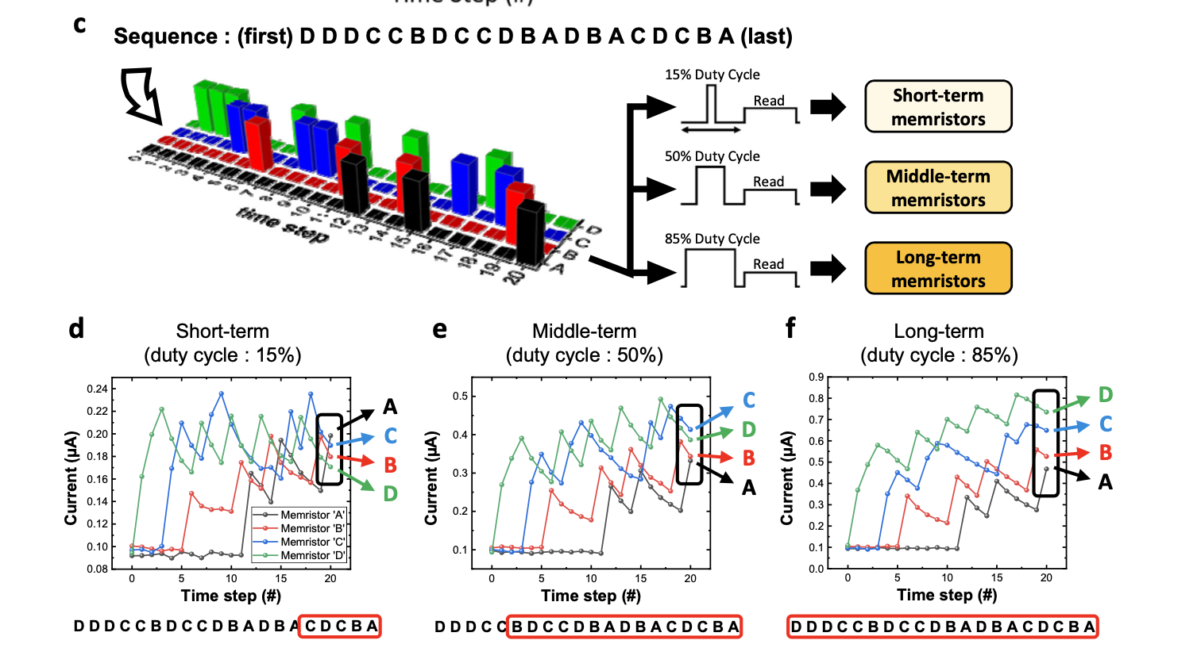
Binary and sequence input processing of the gradual TiOx memristor.
Therefore, if the multiple W/I ratios are utilized for the memristors, different outputs will be obtained from the memristors with different W/I ratios for the same input, which can improve the training of the readout function.
The output of the long-term memristors only contains frequency information of each alphabet, while the order information is clearly shown in the short-term memristors.
Experimental demonstration of highly reliable dynamic memristor for artificial neuron and neuromorphic computing
Notes:
不同的W/I比例导致了不同的动态响应，这有助于神经-记忆计算系统学习输入数据的复杂模式，尤其是在处理序列类型数据时。
因此，如果忆阻器采用多种W/I比，对于相同的输入，不同W/I比的忆阻器将会得到不同的输出，这可以改善读出功能的训练。
长期忆阻器的输出仅包含每个字母的频率信息，而短期忆阻器则清晰地显示了顺序信息。

Slide 15
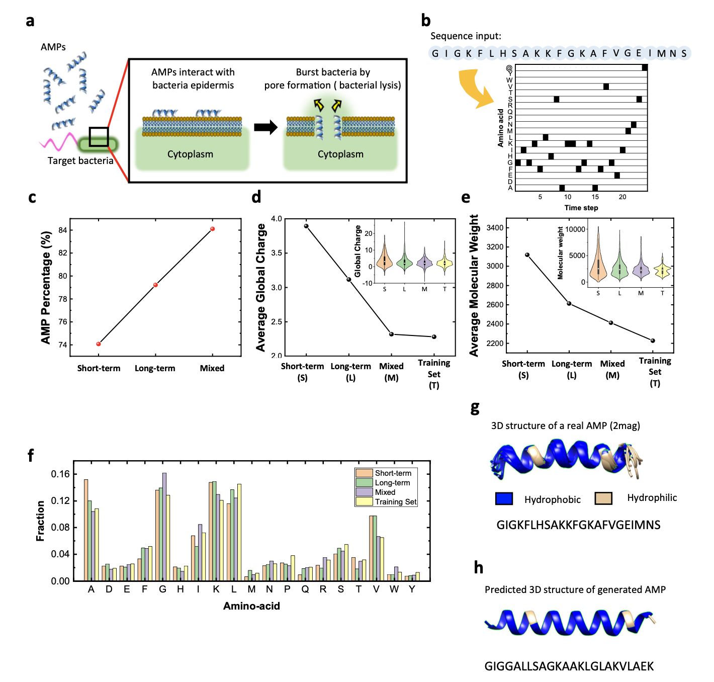
Generated AMP sequences
we propose a neuro-memristive computing system based on the gradual TiOx memristor to generate new, potential AMP sequences.
Fig.j Every neuron operates in the same manner, without any noticeable differences.
The low variation of the artificial neuron originates from the reliable switching behavior of the gradual TiOx memristor.
Experimental demonstration of highly reliable dynamic memristor for artificial neuron and neuromorphic computing
Notes:
训练集包括1554个AMP序列，这些序列来自三个公开的数据库：Anuran防御肽数据库（DADP）38，抗菌肽数据库（APD）39和抗菌肽数据库（ADAM）40。数据集中的每个AMP序列由约7-48个氨基酸残基组成。所有数据都经过预处理，即在每个序列的末尾放置一个结束符。结束符用于表示序列的结束位置。
我们提出了一种基于渐进 TiOx 忆阻器的神经忆阻计算系统，以生成新的、潜在的 AMP 序列。
图 j 每个神经元都以相同的方式运行，没有任何明显的差异。人工神经元的低变化源于渐变 TiOx 忆阻器的可靠开关行为。

Slide 16
Generated AMP sequences
The 3D image of an AMP (protein data bank ID: 2mag44) in the training set.
A predicted 3D image of the generated AMP from the mixed case neuro-memristive computing system.
Experimental demonstration of highly reliable dynamic memristor for artificial neuron and neuromorphic computing
Notes:
图5g、h显示了训练集中AMP序列和具有最高AMP概率的生成序列的3D肽结构

Slide 17
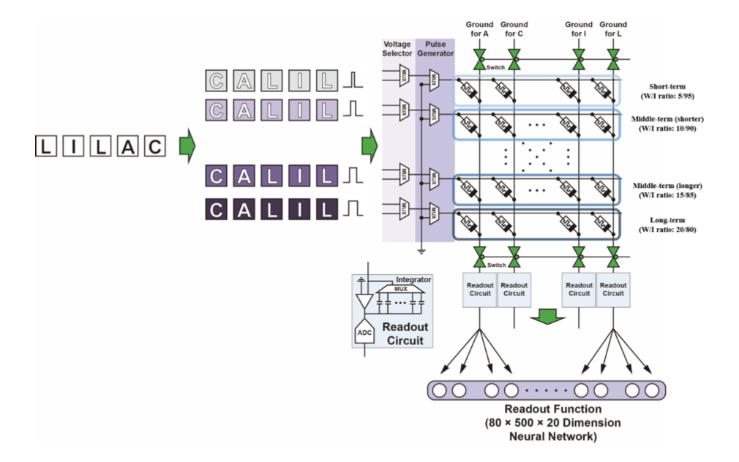
A circuit schematic for the neuro-memristive computing system
The outputs from each memristor device are mapped to each node of the readout function, and the readout function trains its weights with backpropagation method based on the error between the readout function output and the target data.
Experimental demonstration of highly reliable dynamic memristor for artificial neuron and neuromorphic computing
Notes:
每个忆阻器器件的输出被映射到读出函数的每个节点，读出函数根据读出函数输出与目标数据之间的误差通过反向传播方法训练其权重。

Slide 18
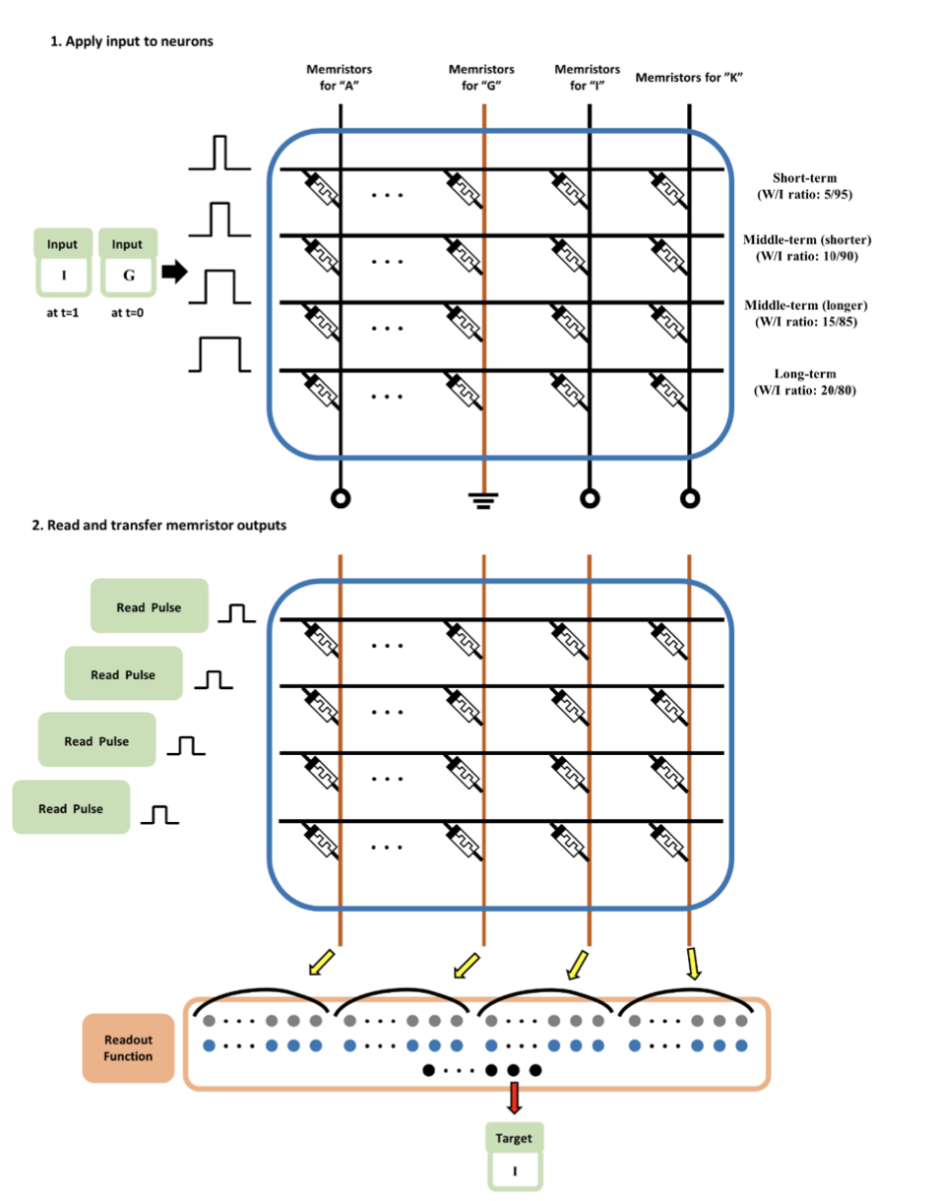
the operation of the developed neuro- memristive computing system.
Based on the error between the readout function’s output and the target “I”, which is the next input of the input “G”, the readout function trains its weights.
Experimental demonstration of highly reliable dynamic memristor for artificial neuron and neuromorphic computing
Notes:
根据读出函数的输出与目标“I”（输入“G”的下一个输入）之间的误差，读出函数训练其权重。

Slide 19
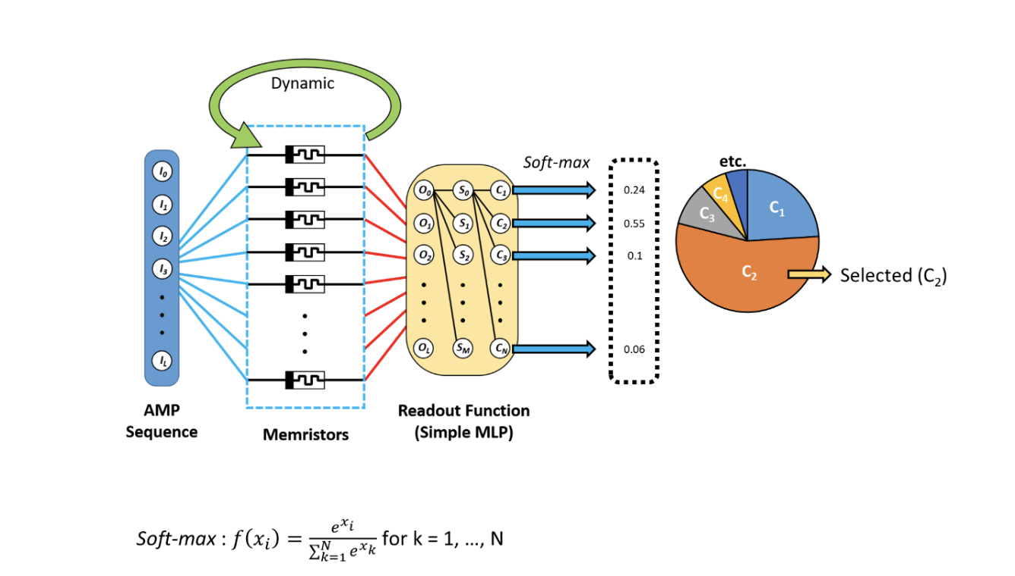
Schematic of the selection of the next amino-acid based on the soft-max output
The system selects the next amino- acid by making the random selection based on the probability from readout function output.
Experimental demonstration of highly reliable dynamic memristor for artificial neuron and neuromorphic computing
Notes:
整个系统的可训练参数数量为50,520，分别适用于单一和混合W/I比率情况。第一和第二层具有修正线性单元（ReLU）作为激活函数，以实现快速高效的学习，第三层具有softmax，以使输出值呈现概率形式。系统根据读出功能的输出选择下一个元素（见补充图25）。然后，基于相应目标“A”和读出功能输出之间的误差，通过使用简单的机器学习算法（对数回归）来训练读出功能的权重。使用Python工具包Keras访问TensorFlow。同一过程（将输入馈送到电阻存储器交叉阵列，将电阻存储器输出馈送到读出功能，选择下一个输出，并根据误差训练权重）重复进行，直到完成序列的训练。当结束光标成为相应目标时，训练序列完成，因为结束光标没有相应的目标。然后，将电阻存储器重置为初始状态。对于每个1554个序列，整个过程都是如此。在整个训练数据上迭代50次（50个时代）后，训练阶段结束，生成阶段开始。 AMP序列的生成是通过将第一个氨基酸（种子）放入电阻存储器交叉阵列中开始的（见补充图26）。为方便起见，我们使用了训练数据中每个AMP的第一个氨基酸作为种子。系统预测了种子的下一个氨基酸，所选的氨基酸成为生成序列的第二个氨基酸元素。由于softmax激活函数，读出功能输出值的总和为1。因此，为了使生成的序列具有变化，根据读出功能输出值的概率分布选择了下一个预测的氨基酸。然后，所选的氨基酸被馈送到电阻存储器交叉阵列中作为输入，这些过程重复进行，直到选择了结束光标。如果生成的序列已经存在于训练数据中，则从生成集中删除该序列。

Slide 20

Notes:
摘要 | 当前，电子器件和材料的研究受到晶体管缩小速度减缓和计算需求呈指数增长的双重驱动，这使得现有数字计算日益受到容量和功耗的限制。一种有前途的替代方法是基于内在器件动力学进行计算，使得每个器件在功能上取代复杂的数字电路，实现自适应的“复杂计算”。记忆电阻器是一类通过其内部电物理过程自然体现高阶动力学的器件。在本综述中，我们讨论了新型材料特性如何实现复杂动力学，并在记忆电阻器器件和系统中定义了不同阶次的复杂性。器件级别的这些固有复杂动力学使得新的计算架构成为可能，例如受大脑启发的神经形态系统，其既具有高能效又具有高计算容量。

Slide 21
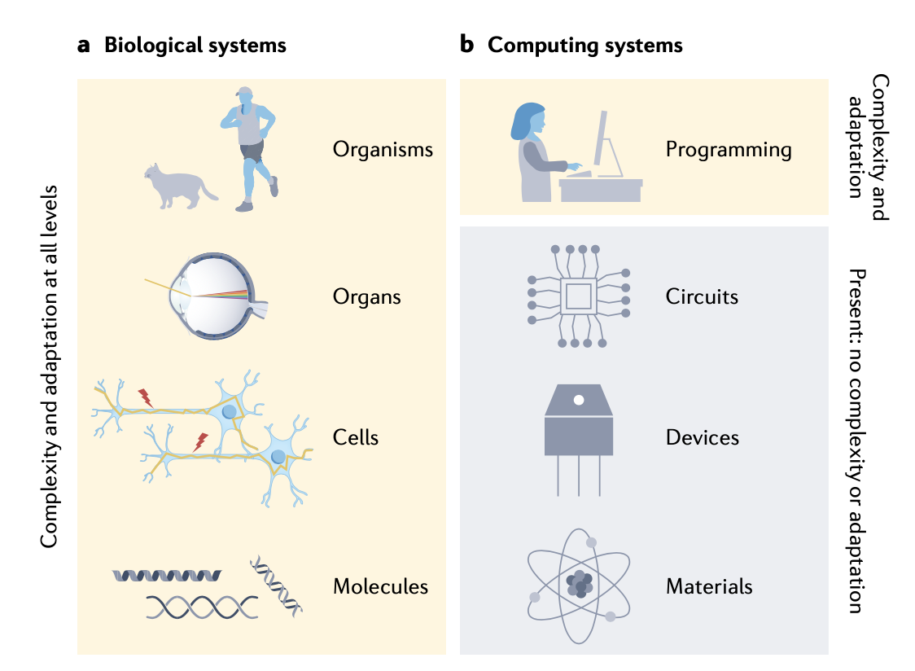
Biological and computational adaptation and complexity
Dynamical memristors for higher-complexity neuromorphic computing

Slide 22
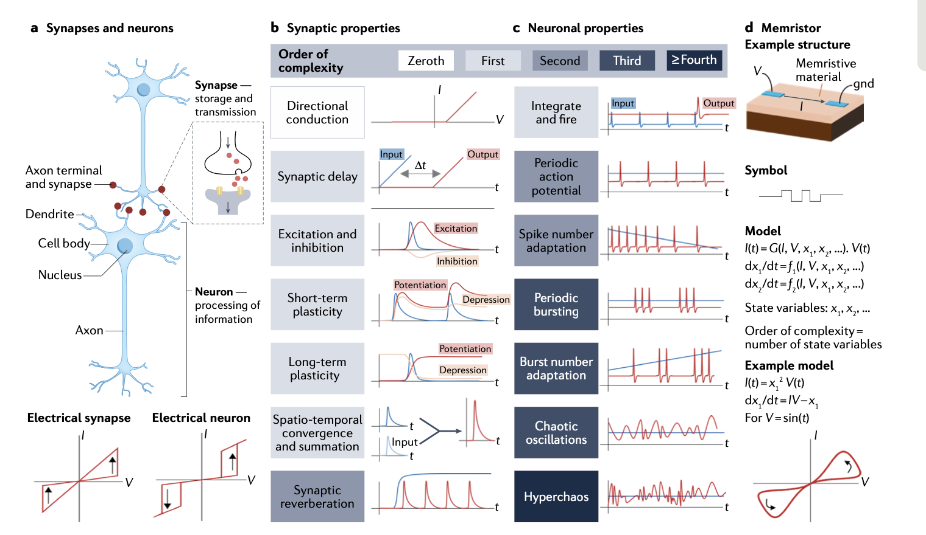
Concept of memristor and memristive behaviours of various complexity
Dynamical memristors for higher-complexity neuromorphic computing

Slide 23
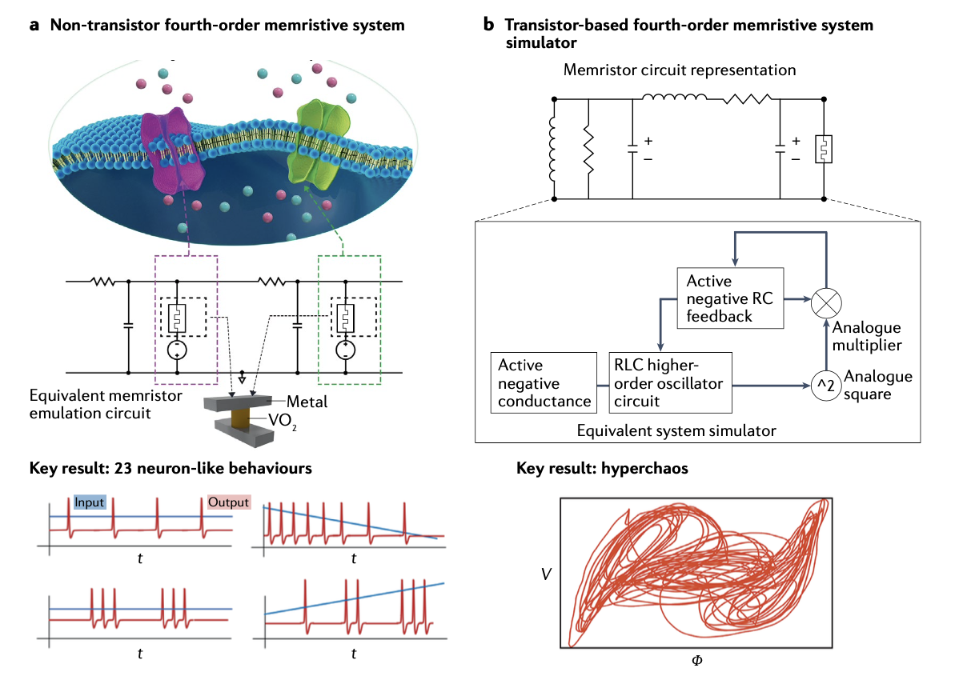
Emulation of higher-order complexity using multiple circuit elements
Dynamical memristors for higher-complexity neuromorphic computing

Slide 24
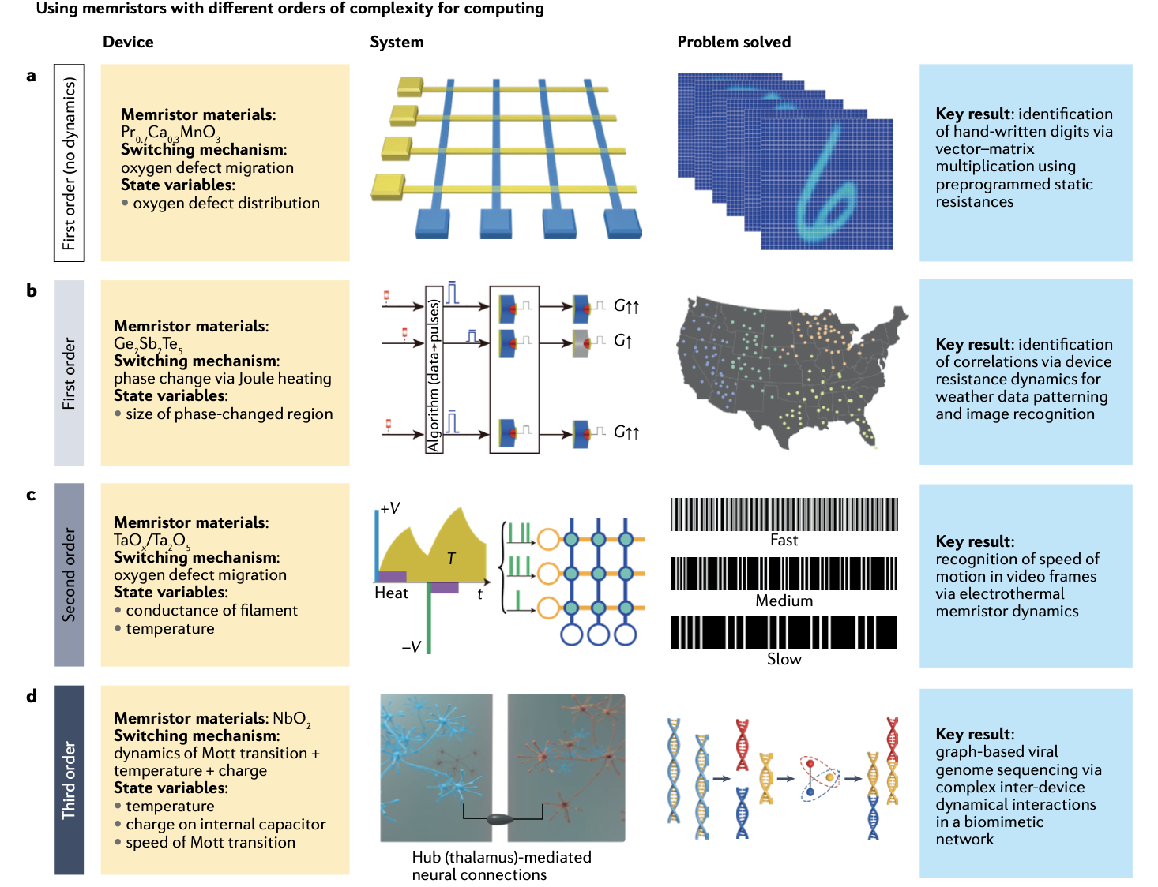
Computing with memristors of different orders of complexity.
Dynamical memristors for higher-complexity neuromorphic computing

Slide 25
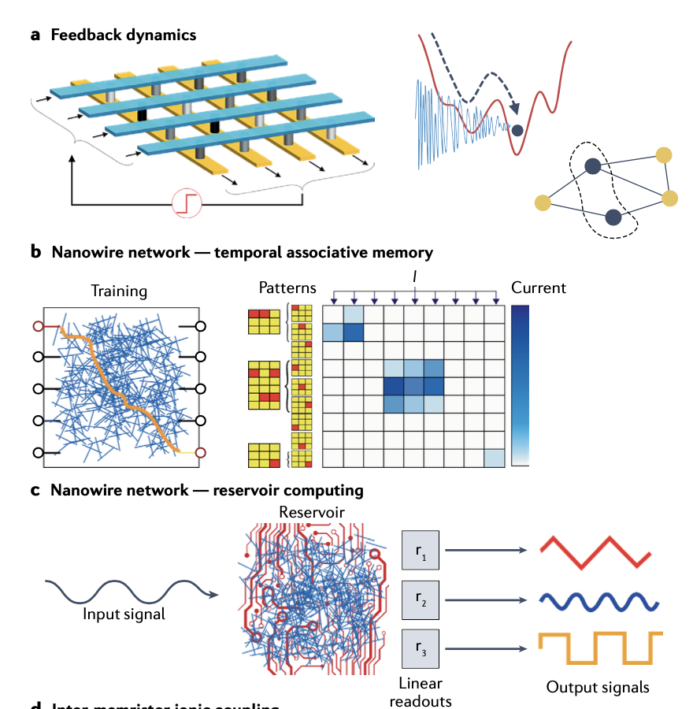
Computing based on spatio-temporal complexity of memristors
Dynamical memristors for higher-complexity neuromorphic computing

Slide 26
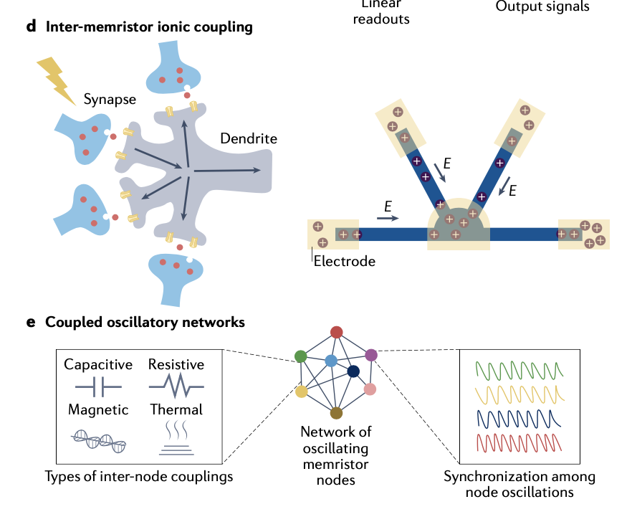
Computing based on spatio-temporal complexity of memristors
Dynamical memristors for higher-complexity neuromorphic computing

Slide 27
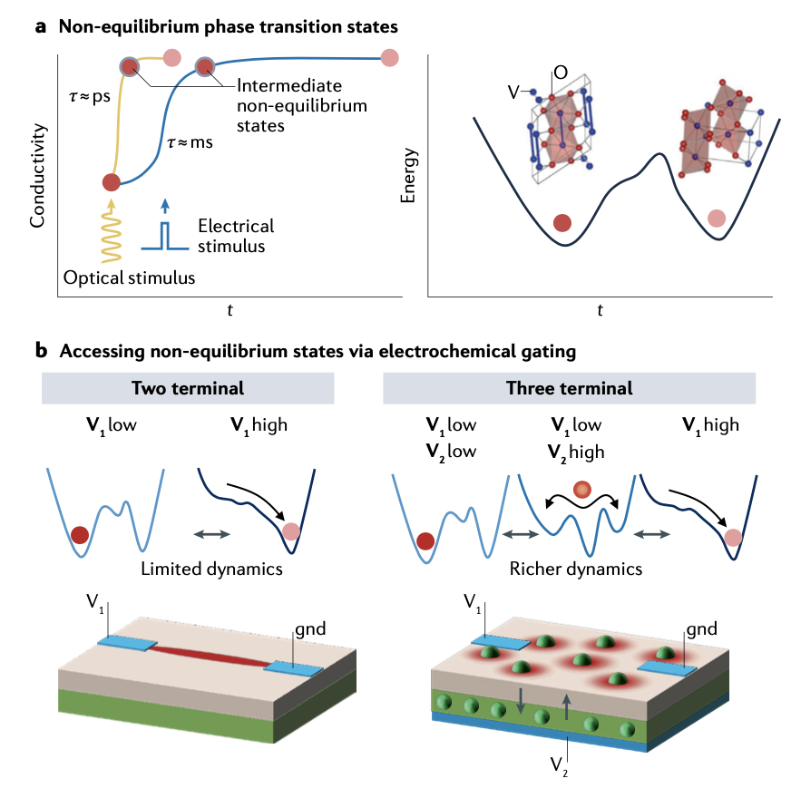
Accessing non-equilibrium phases
Dynamical memristors for higher-complexity neuromorphic computing

Slide 28
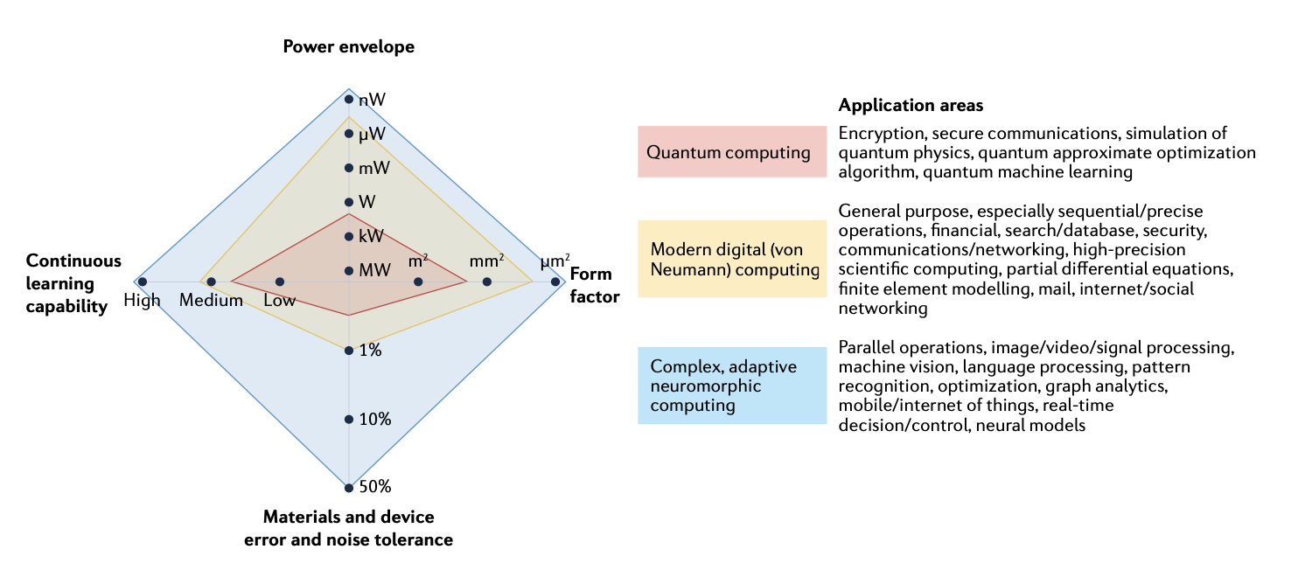
Comparison between the future requirements and
potential of the main computing technologies
Dynamical memristors for higher-complexity neuromorphic computing

Slide 29

Notes:
生物电阻抗谱技术在不同频率域下监测哺乳动物细胞和组织的综述

Slide 30
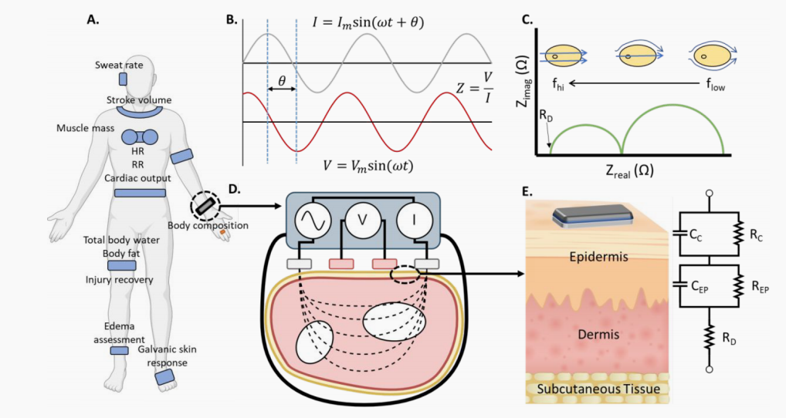
Bioelectrical Impedance
This targeted review discusses
biological events and underlying principles that are employed to analyze the impedance data based on the frequency range.
The emergence of BIA/BIS in wearable devices and its relevance to the Internet of Medical Things (IoMT) are introduced and discussed.
Bioelectrical impedance analysis (BIA) 生物电阻抗分析
Bioelectrical impedance spectroscopy (BIS) 生物电阻抗光谱
Bioimpedance tomography (BIT) 生物阻抗断层扫描
Bioelectrical Impedance Spectroscopy for Monitoring Mammalian Cells and Tissues under Different Frequency Domains: A Review
Notes:
这篇有针对性的综述讨论了生物事件和用于根据频率范围分析阻抗数据的基本原理。
介绍并讨论了 BIA/BIS 在可穿戴设备中的出现及其与医疗物联网 (IoMT) 的相关性。

Slide 31
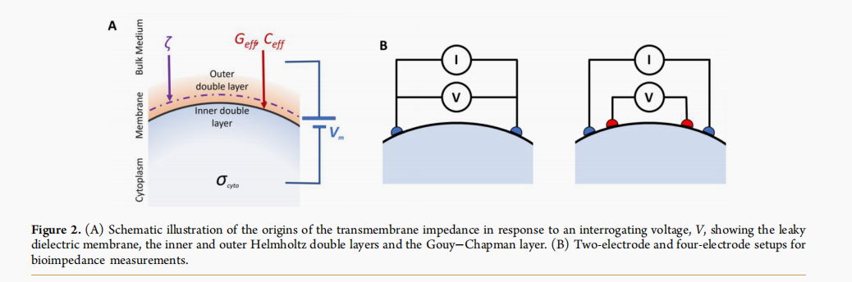
Bioelectrical Impedance
Schematic illustration of the origins of the transmembrane impedance in response to an interrogating voltage
Bioelectrical Impedance Spectroscopy for Monitoring Mammalian Cells and Tissues under Different Frequency Domains: A Review
Notes:
跨膜阻抗响应询问电压 V 的起源示意图

Slide 32
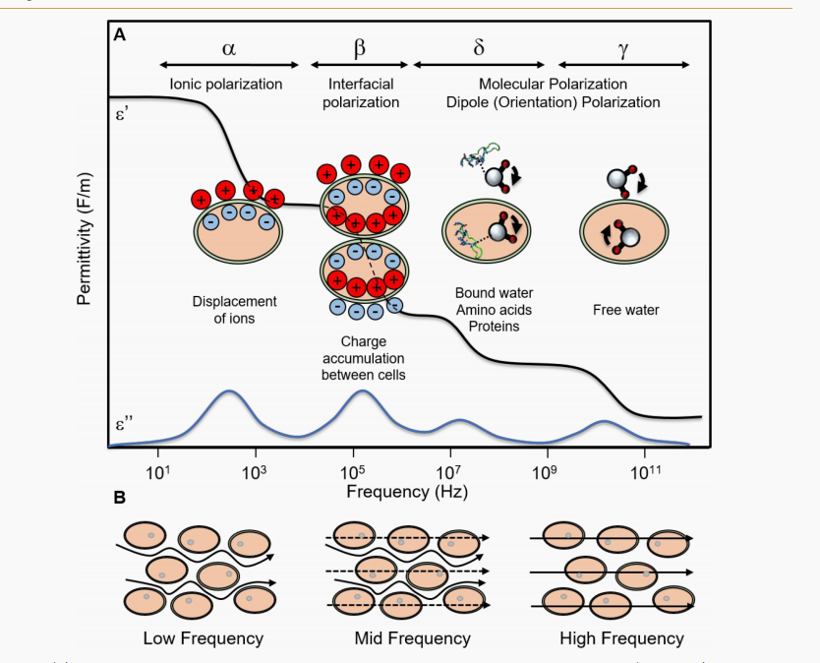
Bioelectrical Impedance
(A)Dispersions of the permittivity occur in four major frequency windows (α, β, δ, γ)
(B) Path of current through cells is dependent on applied frequency
Bioelectrical Impedance Spectroscopy for Monitoring Mammalian Cells and Tissues under Different Frequency Domains: A Review
Notes:
(A)介电常数的色散发生在四个主要频率窗口（α、β、δ、γ）中。
(B) 电流通过细胞的路径取决于所施加的频率。

Slide 33
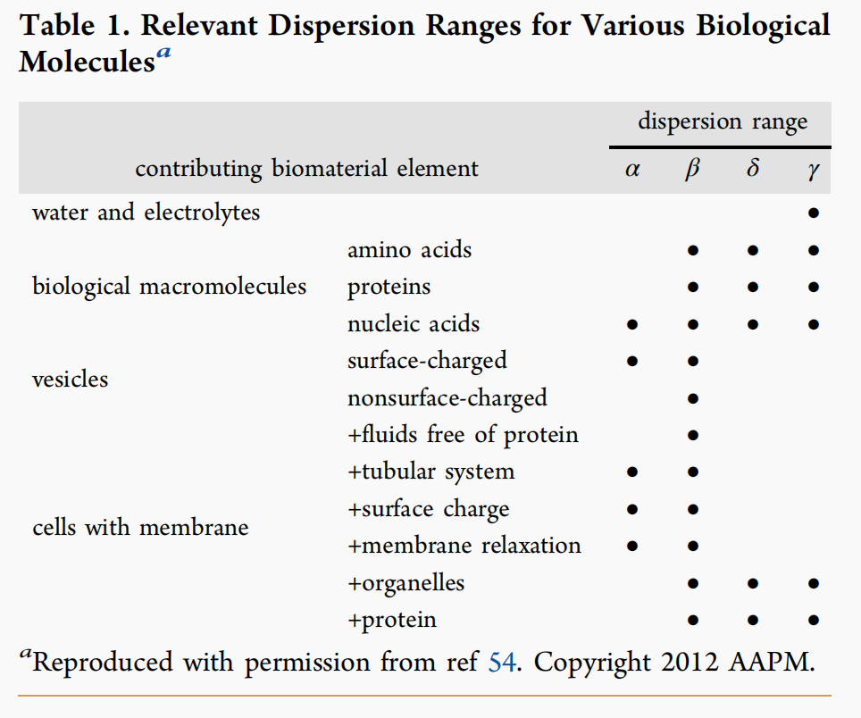
Bioelectrical Impedance
Relevant Dispersion Ranges for Various Biological Molecules
The β range is the most widely used range in bioimpedance studies of biological tissues since it does not have the technical complication of low-frequency (α) measurement yet provides in-depth information about the tissue and its structure.
The use of impedance to study ischemia in dissected and perfused liver and heart
Bioelectrical Impedance Spectroscopy for Monitoring Mammalian Cells and Tissues under Different Frequency Domains: A Review
Notes:
各种生物分子的相关分散范围
β范围是生物组织生物阻抗研究中使用最广泛的范围，因为它没有低频（α）测量的技术复杂性，但提供了有关组织及其结构的深入信息。 3.

Slide 34
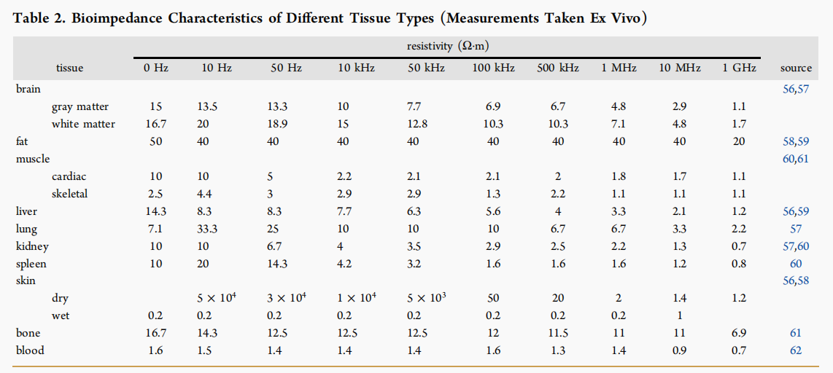
Bioelectrical Impedance
This results in each type of tissue having a distinctive frequency-dependent electrical characteristic summarized in Table 2.
Water content is a helpful marker for evaluating the health of cells, as it is known that some underlying conditions, such as cancer, particularly solid tumors, causes a change in water content of the tissue.
Bioelectrical Impedance Spectroscopy for Monitoring Mammalian Cells and Tissues under Different Frequency Domains: A Review
Notes:
这导致每种类型的组织都具有独特的频率相关电气特性，如表 2 所示。
水含量是评估细胞健康状况的有用标志，因为众所周知，一些潜在疾病（例如癌症，特别是实体瘤）会导致组织水含量的变化。

Slide 35
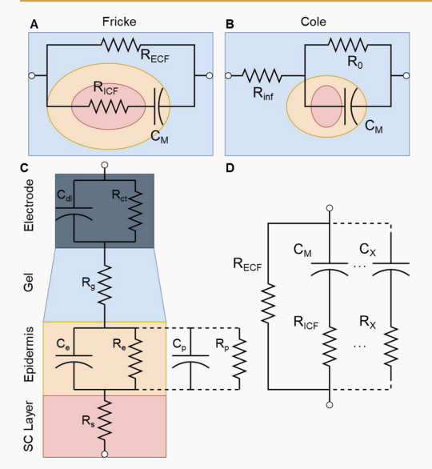
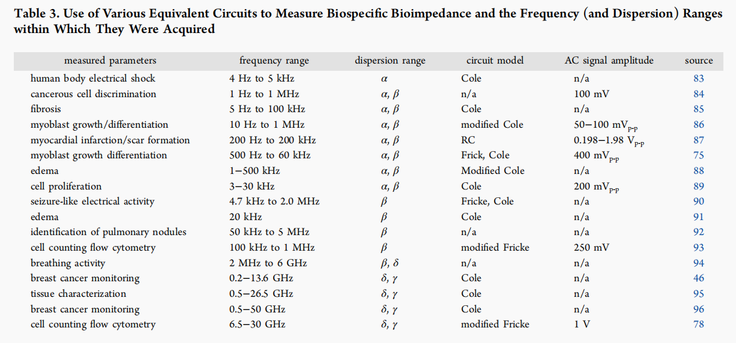
Bioelectrical Impedance
Use of Various Equivalent Circuits to Measure Biospecific Bioimpedance and the Frequency (and Dispersion) Ranges within Which They Were Acquired.
Whether continuously monitoring single cells at a single interrogation frequency, interrogating the health of a tissue before transplantation into a host patient, or characterizing cells or tissues, equivalent circuits must be appropriately designed to model the physiological and physicochemical properties of the TUT.
Bioelectrical Impedance Spectroscopy for Monitoring Mammalian Cells and Tissues under Different Frequency Domains: A Review
Notes:
使用各种等效电路测量生物特异性生物阻抗及其获得的频率（和色散）范围
无论是在单一问诊频率（用于细胞流式细胞术的BIA）连续监测单个细胞，还是在将组织移植到宿主患者之前进行检查，还是在表征细胞或组织，都必须适当设计等效电路来模拟待测物理和物理化学特性。

Slide 36
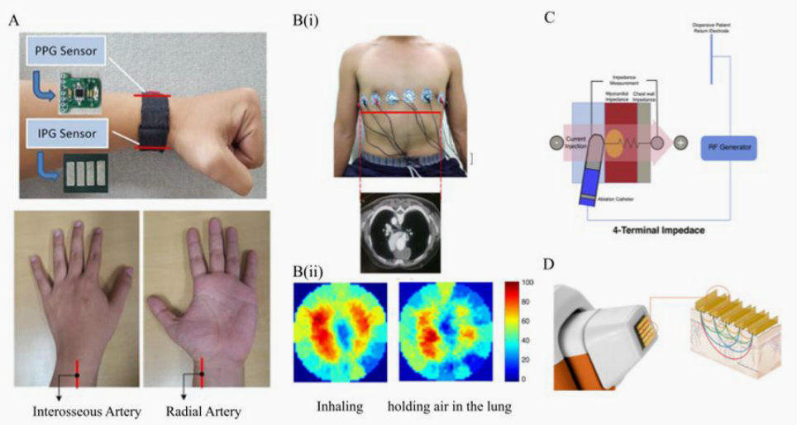
Bioelectrical Impedance
(A) Impedance plethysmography (IPG) based measurements for developing a cuffless blood pressure recorder.
(B) Cross-sectional image constructed using bioimpedance tomography.
(C) Ablation catheter with two pairs of electrodes
(D) Nevisense probe for measuring impedance on skin to detect melanoma.
Bioelectrical Impedance Spectroscopy for Monitoring Mammalian Cells and Tissues under Different Frequency Domains: A Review
Notes:
(A) 基于阻抗体积描记法 (IPG) 的测量，用于开发无袖血压记录仪。
(B) 使用生物阻抗断层扫描构建的横截面图像。
(C) 具有两对电极的消融导管
(D) Nevisense 探针，用于测量皮肤阻抗以检测黑色素瘤。

Slide 37
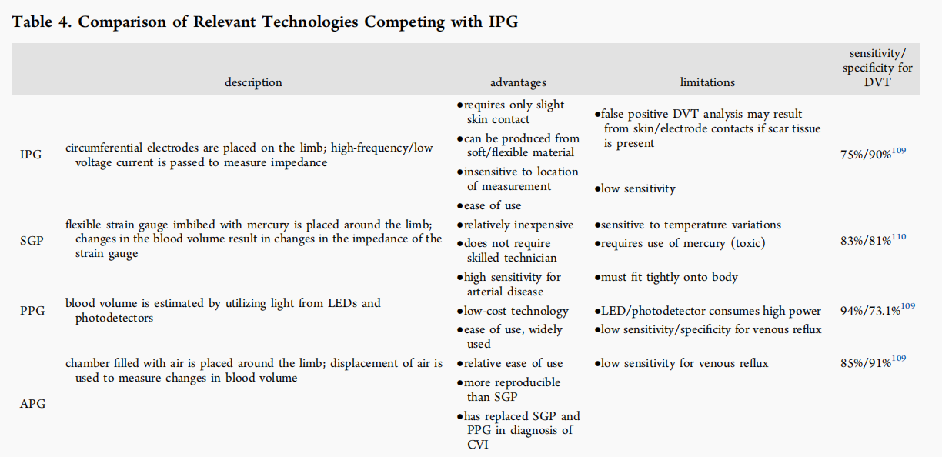
Comparison of Relevant Technologies Competing with IPG
Impedance plethysmography (IPG) is a diagnostic tool that measures changes in the volume of an organ or tissue from recorded bioimpedance changes using skin-contact electrodes
strain gauge plethysmography (SGP) which measures the resistance of rubber tubes filled with displaceable mercury
photoplethysmography (PPG) which employs photo detectors
air plethysmography (APG) which uses an air filled cuff
Bioelectrical Impedance Spectroscopy for Monitoring Mammalian Cells and Tissues under Different Frequency Domains: A Review
Notes:
阻抗体积描记法 (IPG) 是一种诊断工具，通过使用皮肤接触电极记录的生物阻抗变化来测量器官或组织的体积变化
应变计体积描记法 (SGP)，用于测量充满可置换水银的橡胶管的电阻
采用光电探测器的光电体积描记法 (PPG)
使用充气袖带的空气体积描记法 (APG)

Slide 38
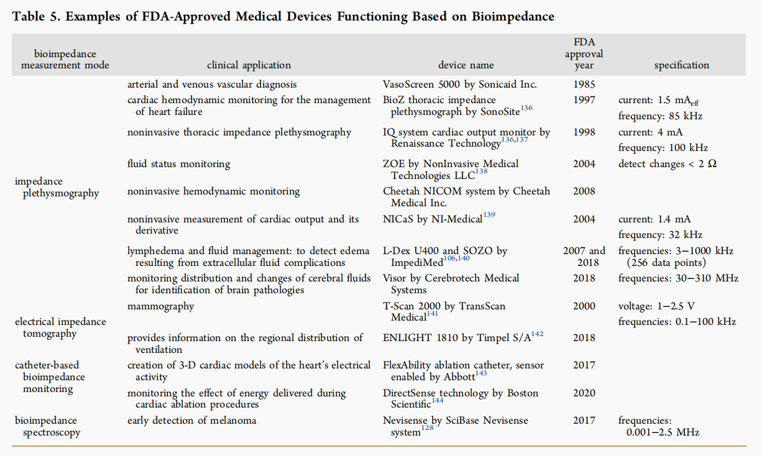
Examples of FDA-Approved Medical Devices Functioning Based on Bioimpedance
The chest worn patch, which houses two ECG bioimpedance electrodes, measures vital signs including respiration and heart rate, posture, activity level, and ambulation.
A necklace designed to be used in remote patient monitoring, postdischarge monitoring, and clinical monitoring applications about the heart rate, respiration rate, skin temperature, stroke volume, posture, and cardiac output.
Bioelectrical Impedance Spectroscopy for Monitoring Mammalian Cells and Tissues under Different Frequency Domains: A Review
Notes:
胸前佩戴的贴片装有两个心电图生物阻抗电极，可测量生命体征，包括呼吸和心率、姿势、活动水平和行走。
项链设计用于远程患者监测、出院后监测以及有关心率、呼吸频率、皮肤温度、每搏输出量、姿势和心输出量的临床监测应用

Slide 39
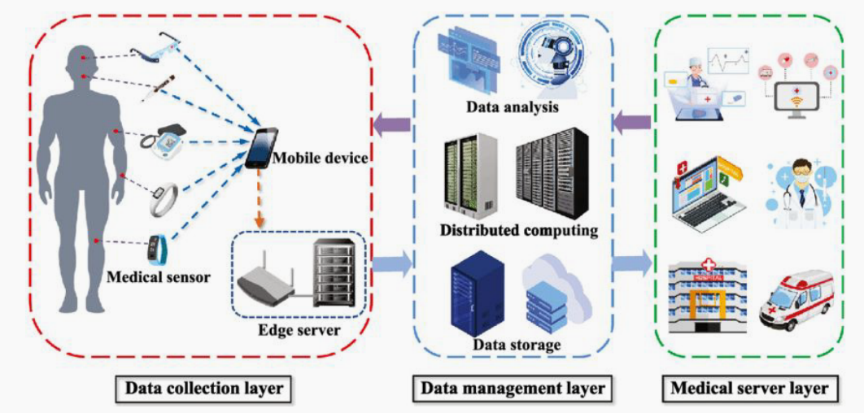
Three-layer architecture used in IoMT
perception layer, where sensor measurements are made andfrom which data are transmitted;
network layer that connects the transmitted sensor data to other network devices using routers via Internet Protocol (IP);
application layer, where patient-specific and/or physician-specific interfaces enable interactivity.
Bioelectrical Impedance Spectroscopy for Monitoring Mammalian Cells and Tissues under Different Frequency Domains: A Review
Notes:
感知层，进行传感器测量并传输数据；
网络层，使用路由器通过互联网协议（IP）将传输的传感器数据连接到其他网络设备；
应用层，患者特定和/或医生特定的界面可实现交互。

